Slide 2
46 years old lady
Dyspnea of excercise and Palpitation from 6 mo ago

Slide 3
She had successful pregnancy 3 mo ago
No DM, No HTN
No Drug
No smoker

Slide 4
BP: 120/80 mmHg
HR: Irregular 120 bpm
JVD
Heart: Tachycardia, Loud S2 (P2), 2/6 PMI diastolic murmur
Lung: 2/6 basal rales
2+ Pitting edema

Slide 5
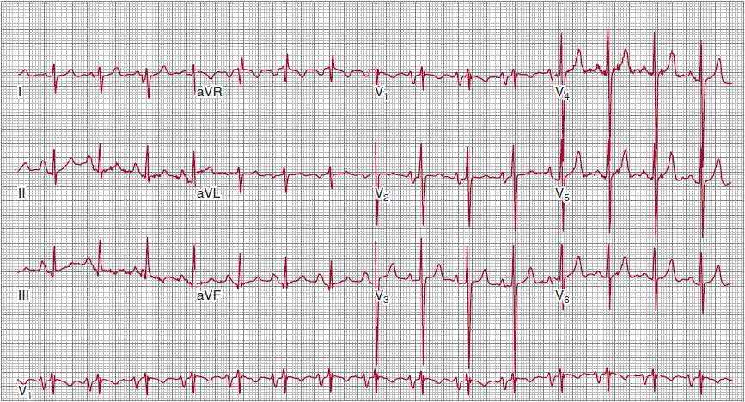

Slide 6
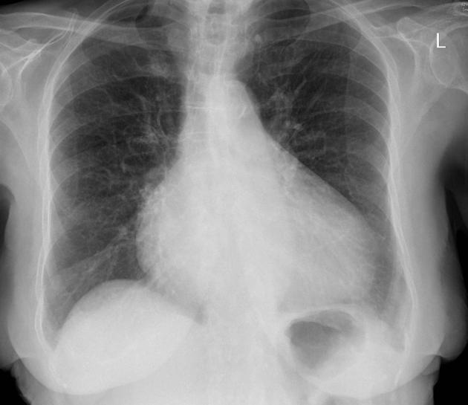

Slide 8
65 years old man Presented with acute onset retrosternal chest pain.
His Pain not relieved with resting.
He has Diaphoresis and one episode of vomiting.

Slide 9
BP: 155/95 mmHg.
HR: 110 bpm

Slide 10
